Slide 1
Team
DeepPhoenix.ai Welcomes
You
Uma sankar Sahoo
Khushaboo Verma
Sidharth Patro

Slide 2
A Machine Learning Model for
Detection of fraudulent transactions
in
Apple using
Anomaly detection technique

Slide 3


Problem Statement:
Users have to manually find frauds through front-end reports.
The occurrence of fraudulent transaction is very rare which is very cumbersome task to address.
Apple revenue loss “ FACTS to be ADDED”
High consumption human efforts in tracing.

Slide 4
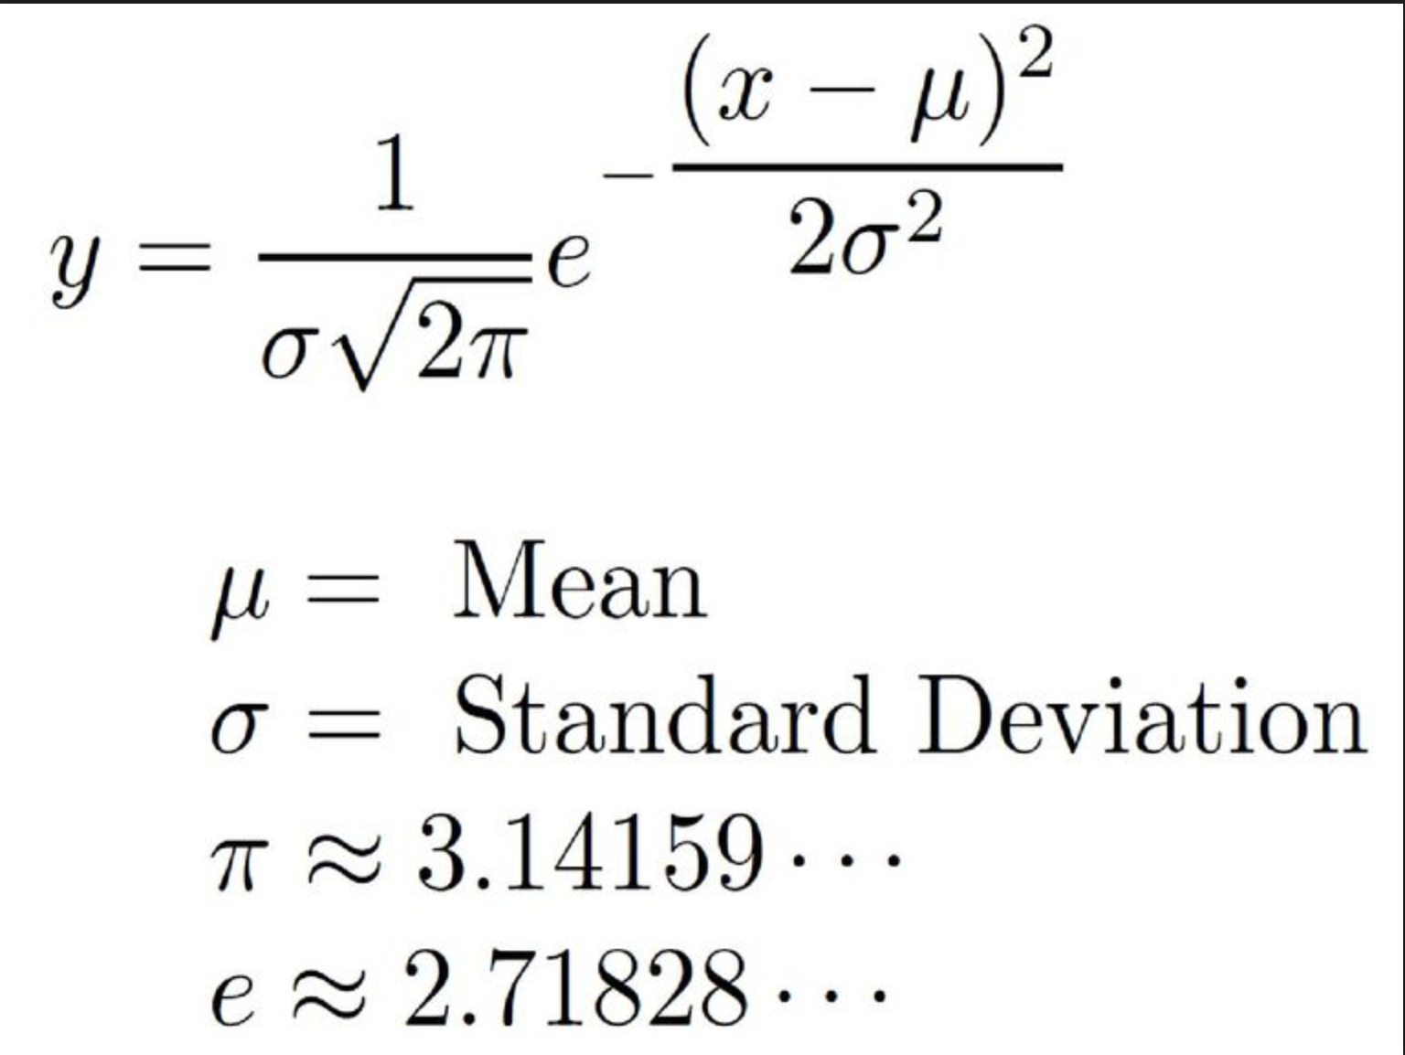
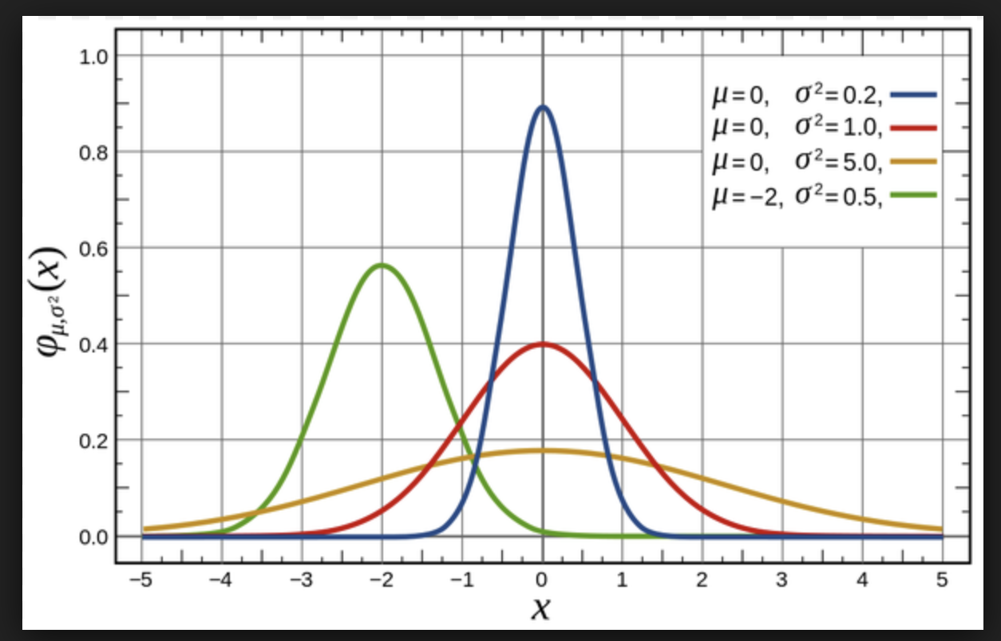
Approach:
By the help of anomaly detection algorithm through Gaussian Distribution.
It basically finds out the Probability of each features which will be behaving very unusual manner.
2

Slide 5
WHY GAUSSIAN????

Slide 6
Model and Training Data

Slide 7
Flow Diagram:

Slide 8
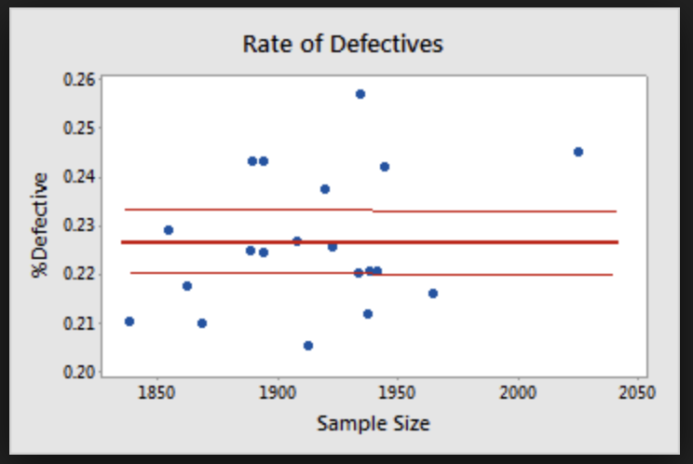
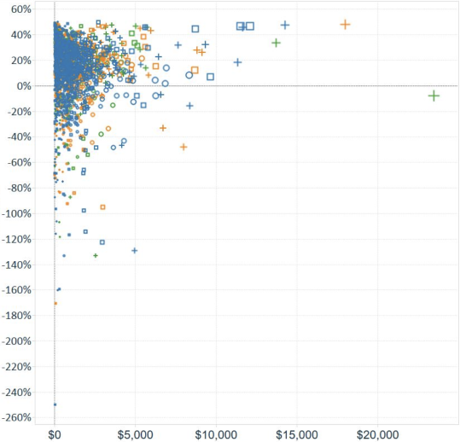

Scope areas in Apple:
Detecting Manufacturing defects in in the end products
Identifying redundant user tickets.
Optimizing storage space of users.
Monitoring consumer behavior during festive hours.
Finding defects Finding Storage space usage
4

Slide 9
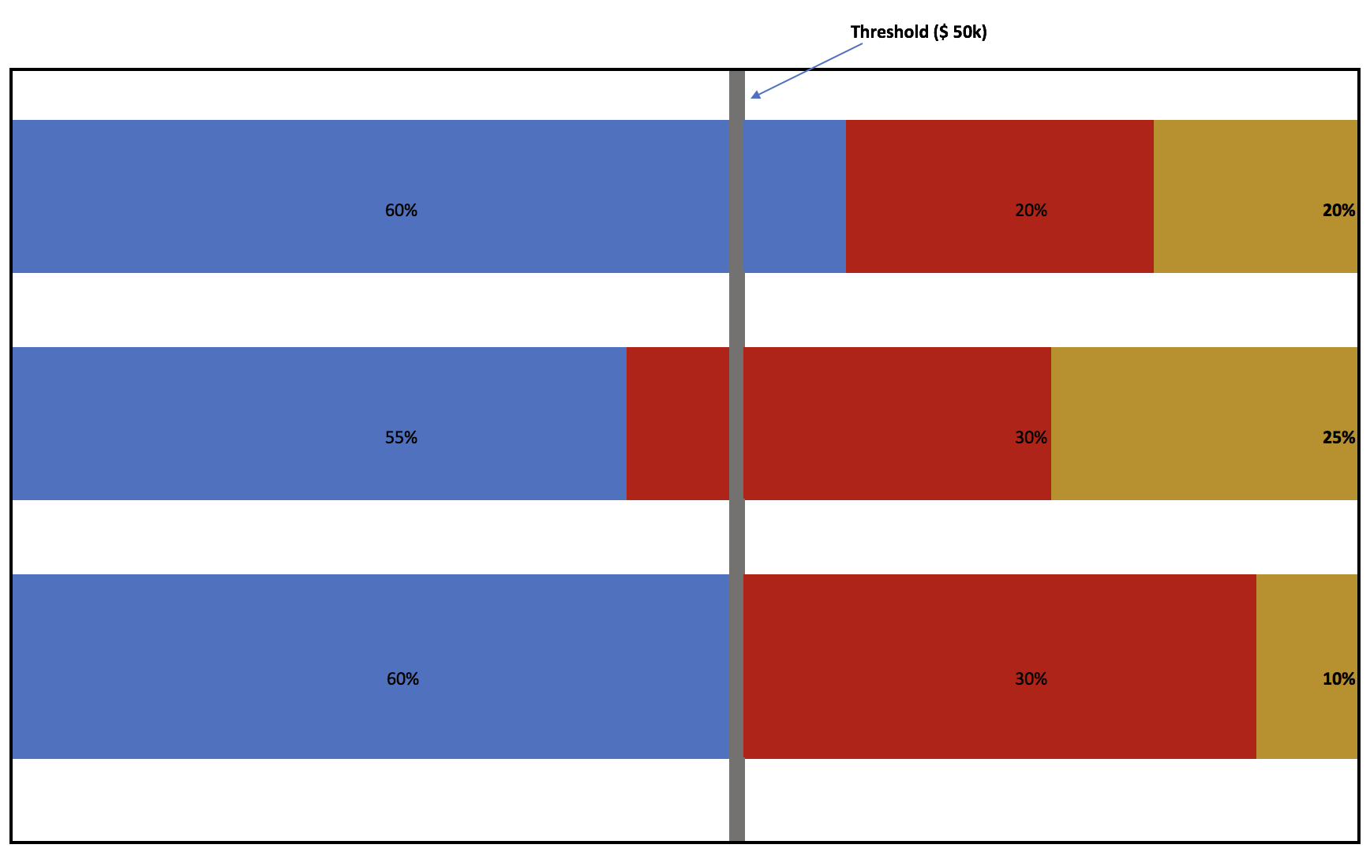
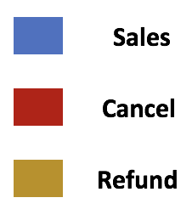

Slide 10
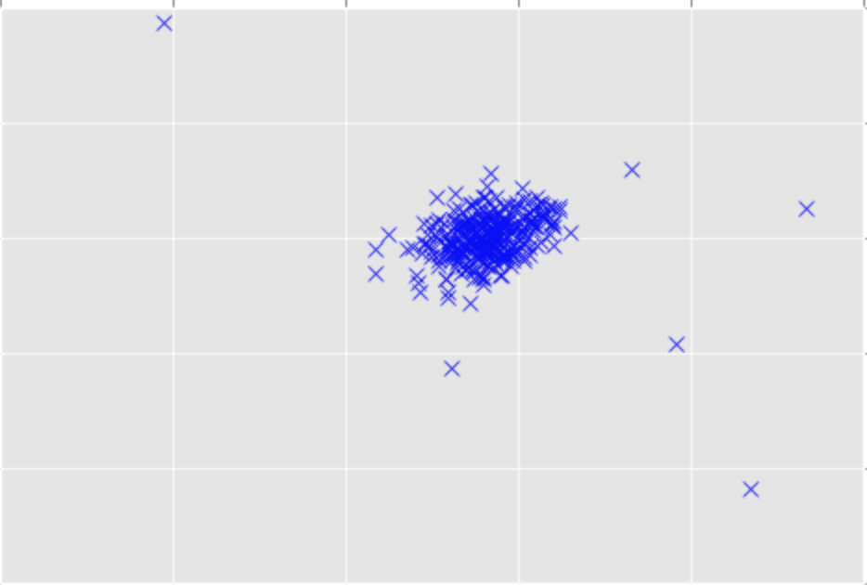
Fraudulent transactions detection using Anomaly Detection Technique
What is Anomaly detection?
The problem of Identifying the points which do not show normal behavior.
1

Slide 11
Facts and Evaluation Sheet of our Model:

